Slide 1


"Gweithio gyda'n gilydd oll ynghyd."
"Gweithio gyda'n gilydd oll ynghyd."
"Working together in harmony."
"Working together in harmony."

Slide 2
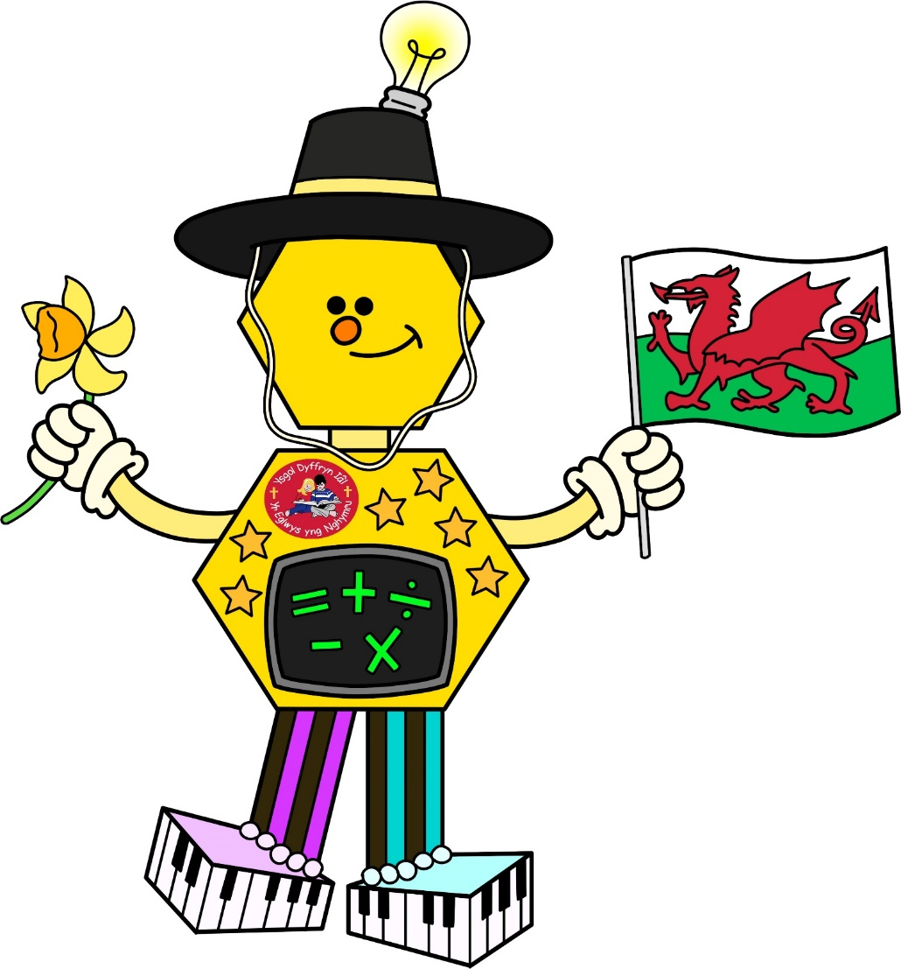
Ambitious Capable Ana
I can try my best and challenge myself
I can find out information and give my opinion
I can use my knowledge and skills in different ways
I can understand data and use my mathematical skills
I can ask questions and enjoy solving problems
I can use digital technology to create, communicate and find information
I can communicate and explain my ideas in different languages
I am ready to lead fulfilling lives as valued members of society

Slide 3
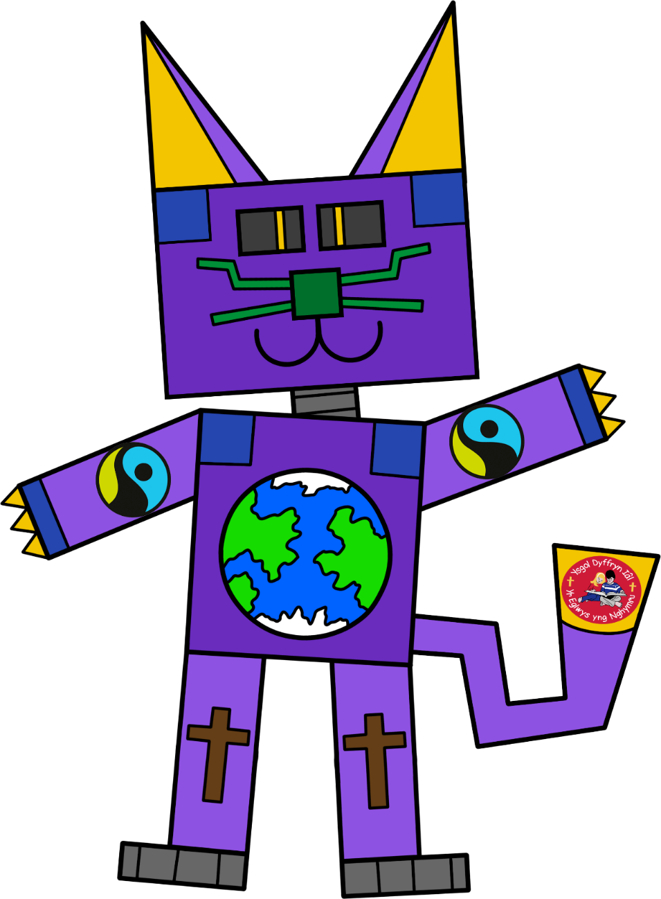
Ethically Informed Edi
I can use information to help me have an opinion
I can show that I know about the world around me now and in the past
I can find out good and bad things that are happening in the world and how it could affect
I can show respect for people in the world around me
I can understand that I have rights and responsibilities
I can understand how important it is that we look after our planet
I can understand that what I do has an effect on others
I am ready to be citizens of Wales and the world.

Slide 4

Healthy Confident Hana
I can become more confident and resilient
I can show confidence when performing
I can understand how to treat others and understand what other people are feeling
I can overcome challenge
I can use knowledge and skills to become more independent
I can understand how to keep healthy by eating a balanced diet and taking part in regular exercise
I can make and be a good friend
I can take part in physical activity
I can find information to keep me safe
I am ready to lead fulfilling lives as valued members of society

Slide 5
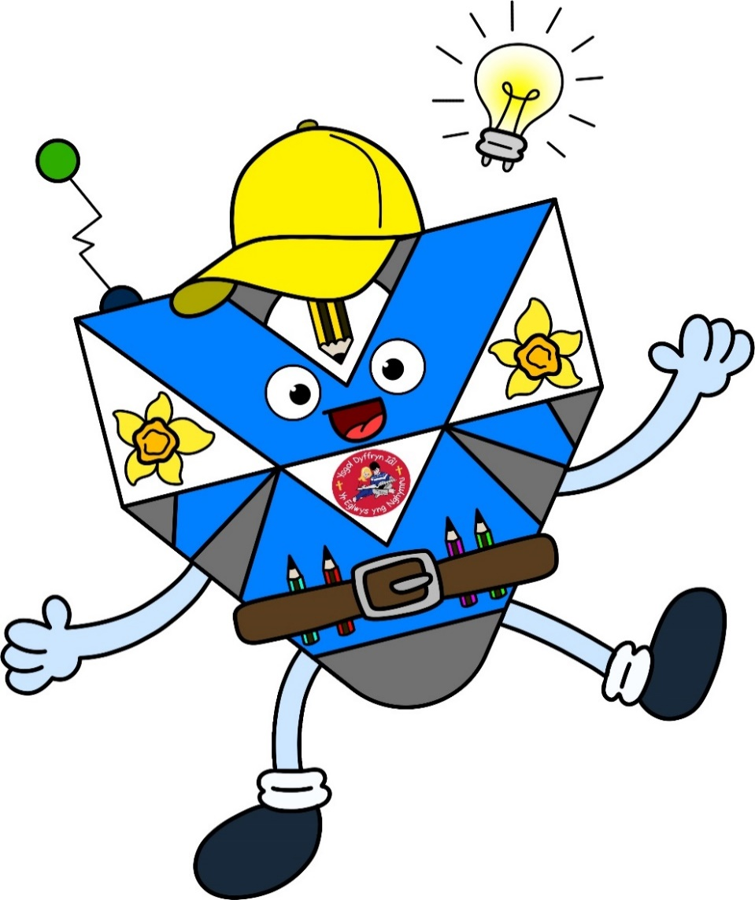
Enterprising Creative Efan
I can understand my knowledge and skills to create something new
I can work well in a team taking different roles
I can think of different ways to solve a problem
I can show my ideas and emotions using different media
I can use information to help me take risks
I can use my energy and skills to help others
I can make the most of every opportunity
I am ready to play a full part in life and work

